Slide 1
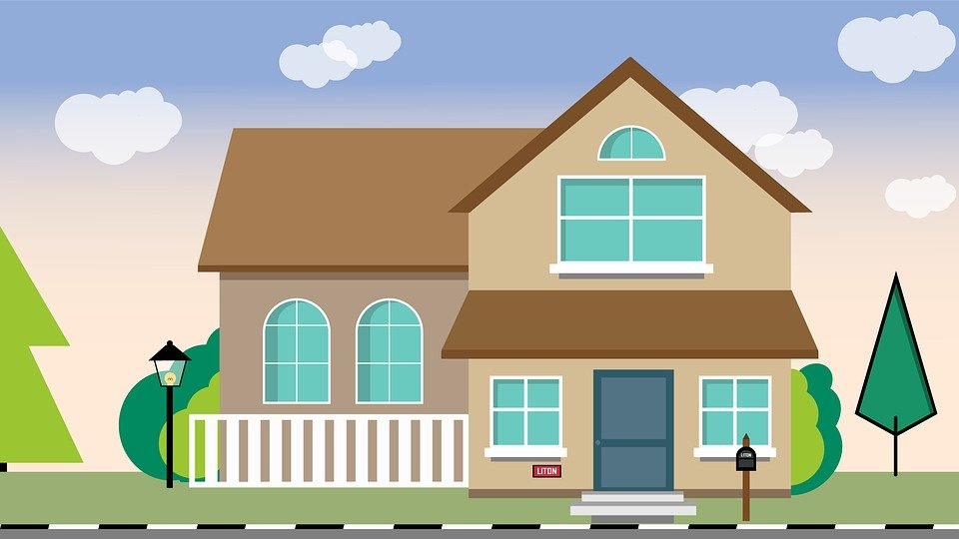
Learning at Home

Slide 2
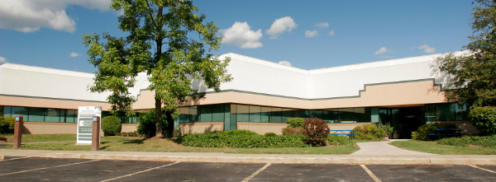
My school is closed to help stop the spread of germs.

Slide 3
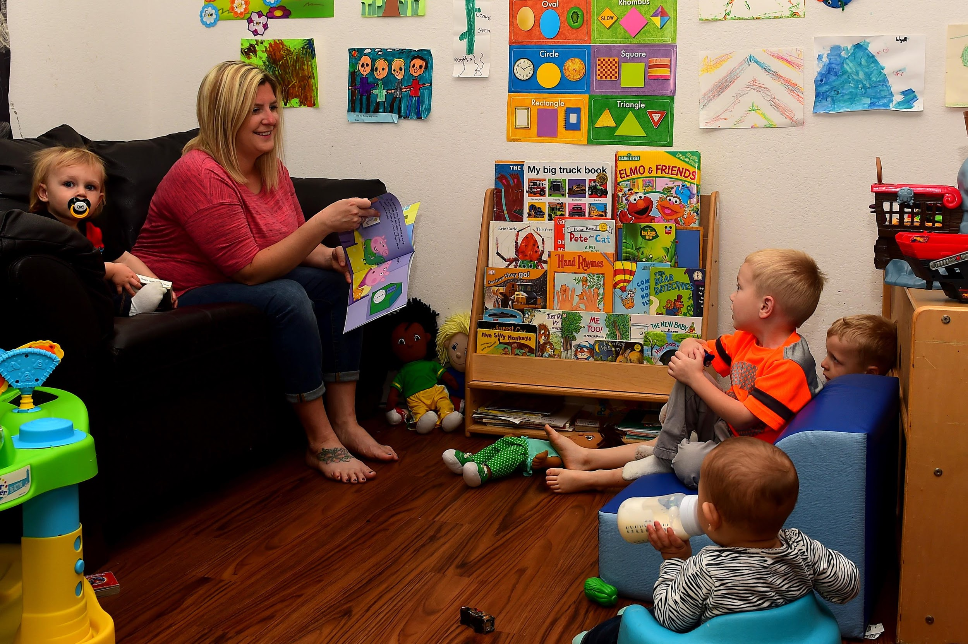
When I can’t go to school to learn, my family can help me learn at home.

Slide 4
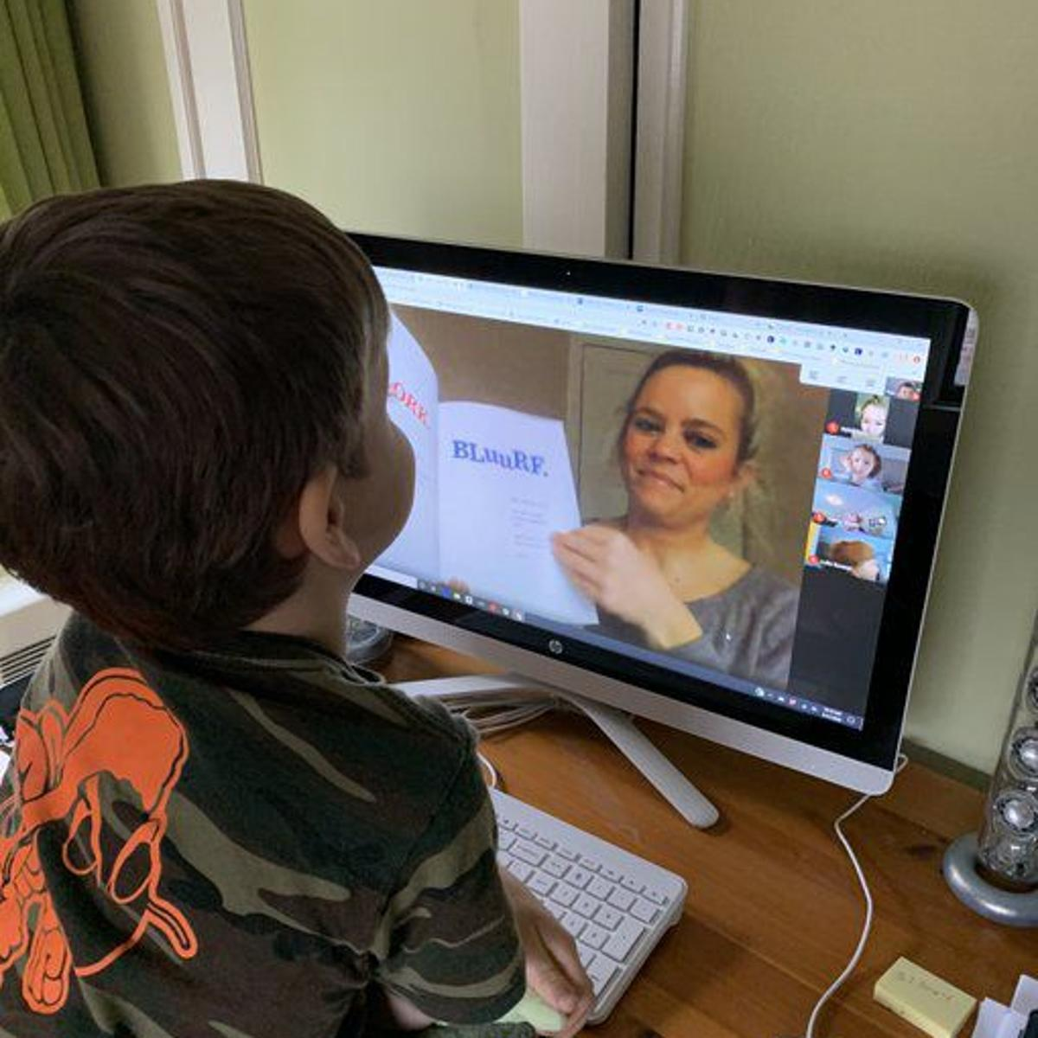
Sometimes I will see my teachers on the screen and they will help me do my work.

Slide 5
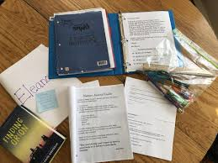
Some teachers will send home paper activities, and others will show me activities on the screen.

Slide 6
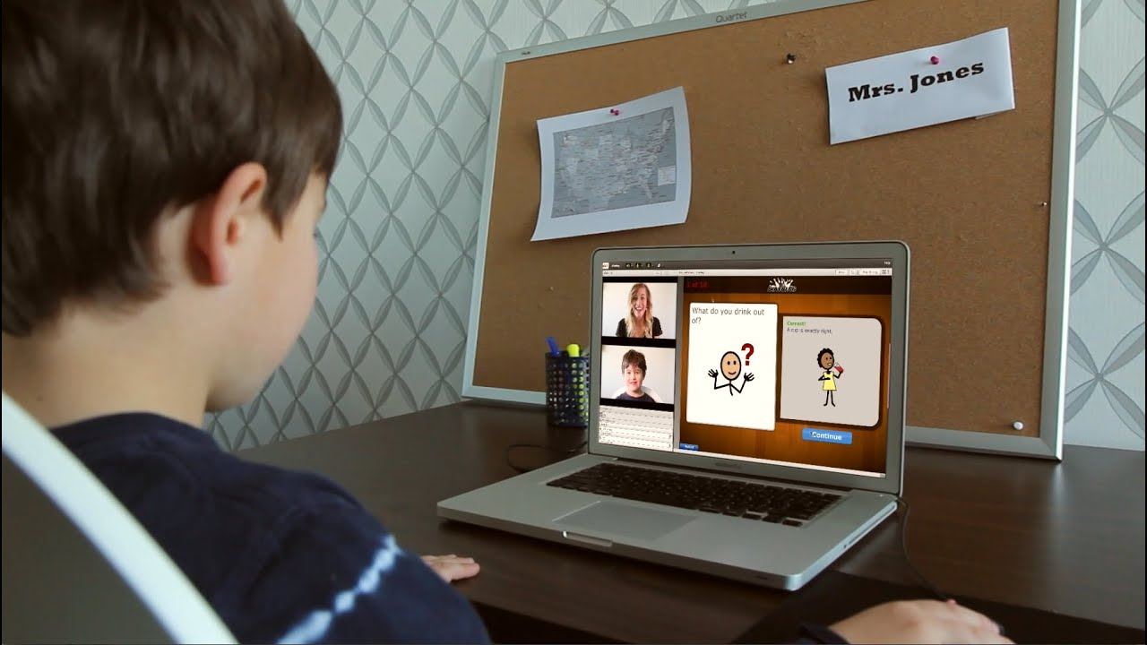
It is important to keep my body calm until an adult tells me to take a turn.

Slide 7
I need to have my eyes on the activity and ears listening to the adult I am working with.

Slide 8
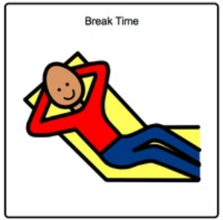
Learning at home is new for me, my teachers, and my family. It is okay to take a break when I need it.

Slide 9
When I try my best, my teachers and family will be so proud of me!

